Slide 1
Update: Data analyses Tracking-Task A and B
14.09.2022

Slide 2
Preprocessing
FPz as reference electrode
Downsampling to 250 Hz
Highpass filter for 1 Hz
Remove line noise at 50 Hz
Remove bad channels (flat, minimum channel correlation)
Lowpass filter 40 Hz
Interpolate bad channels
Rereference to average
Merge data for task A & B: for ICA, epoch data, detrending, artifact rejection
run ICA (extended infomax algorithm)
Iclabel: keep only those Ics that are labelled as neural component with at least 0.5 probability
Visual checks of remaining components
Parallelize behavioral and EEG data → add triggers etc.
Epoch data: 1) for whole trial (-1 13) → baseline correction for fixcross interval (-750 0)
2) -1 4 for task A and B, later reduced to relevant time interval
Artifact rejection for segments

Slide 3
Wavelet analysis

Slide 4
CBPT A & B

Slide 5
Pipeline DICS Beamforming

Slide 6
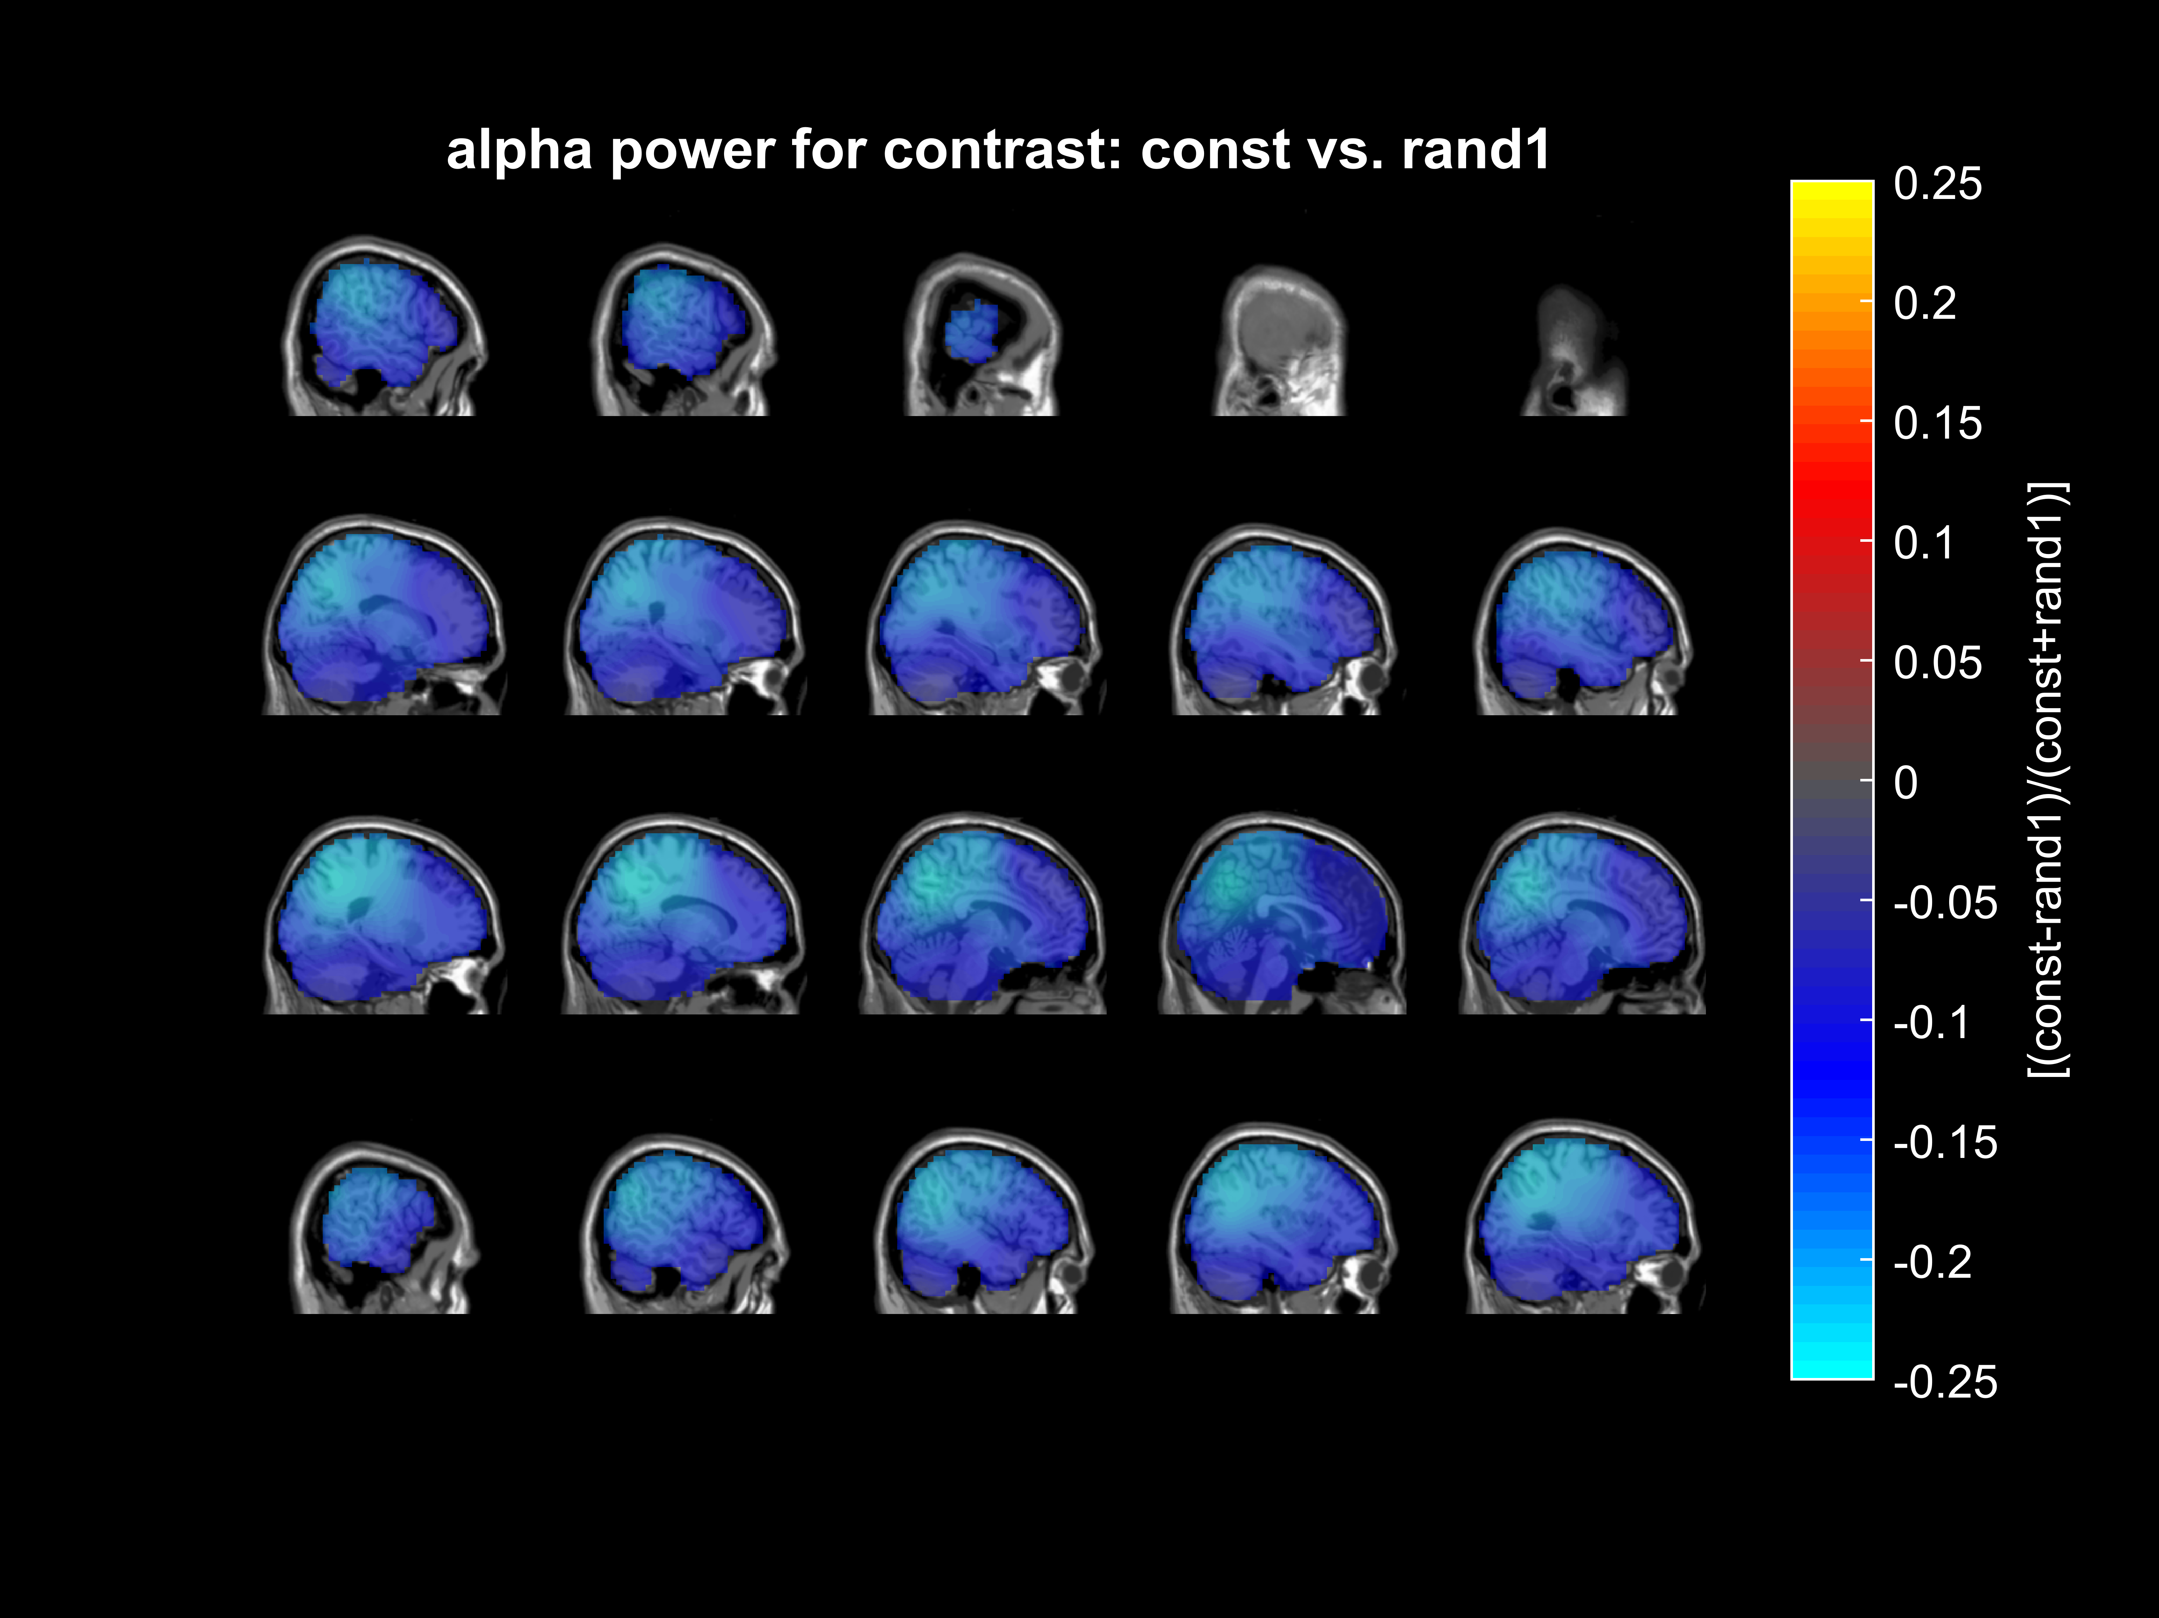
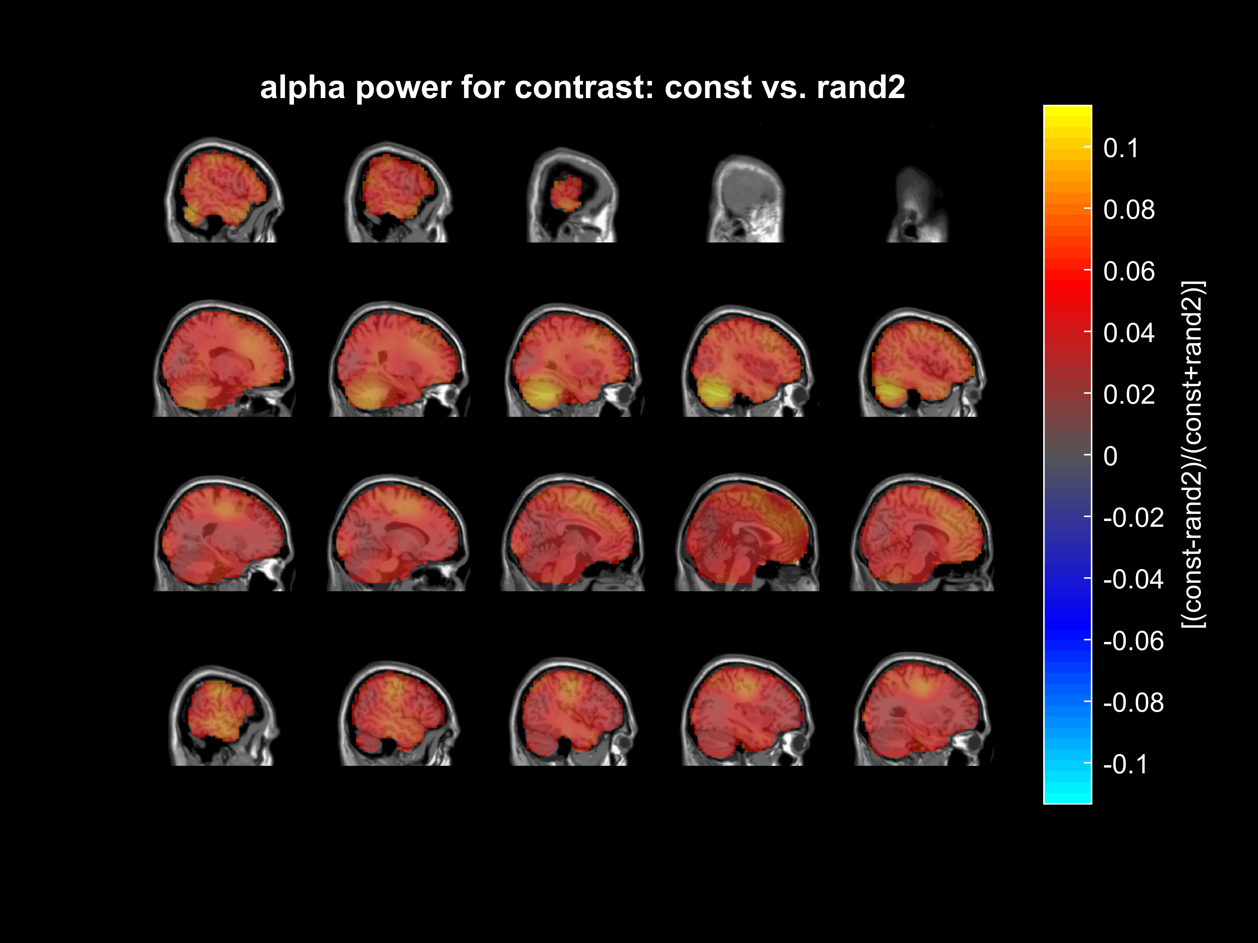
Task A: alpha power
Significant time interval: 0 – 512 ms
Significant time interval: 0 – 512 ms

Slide 7

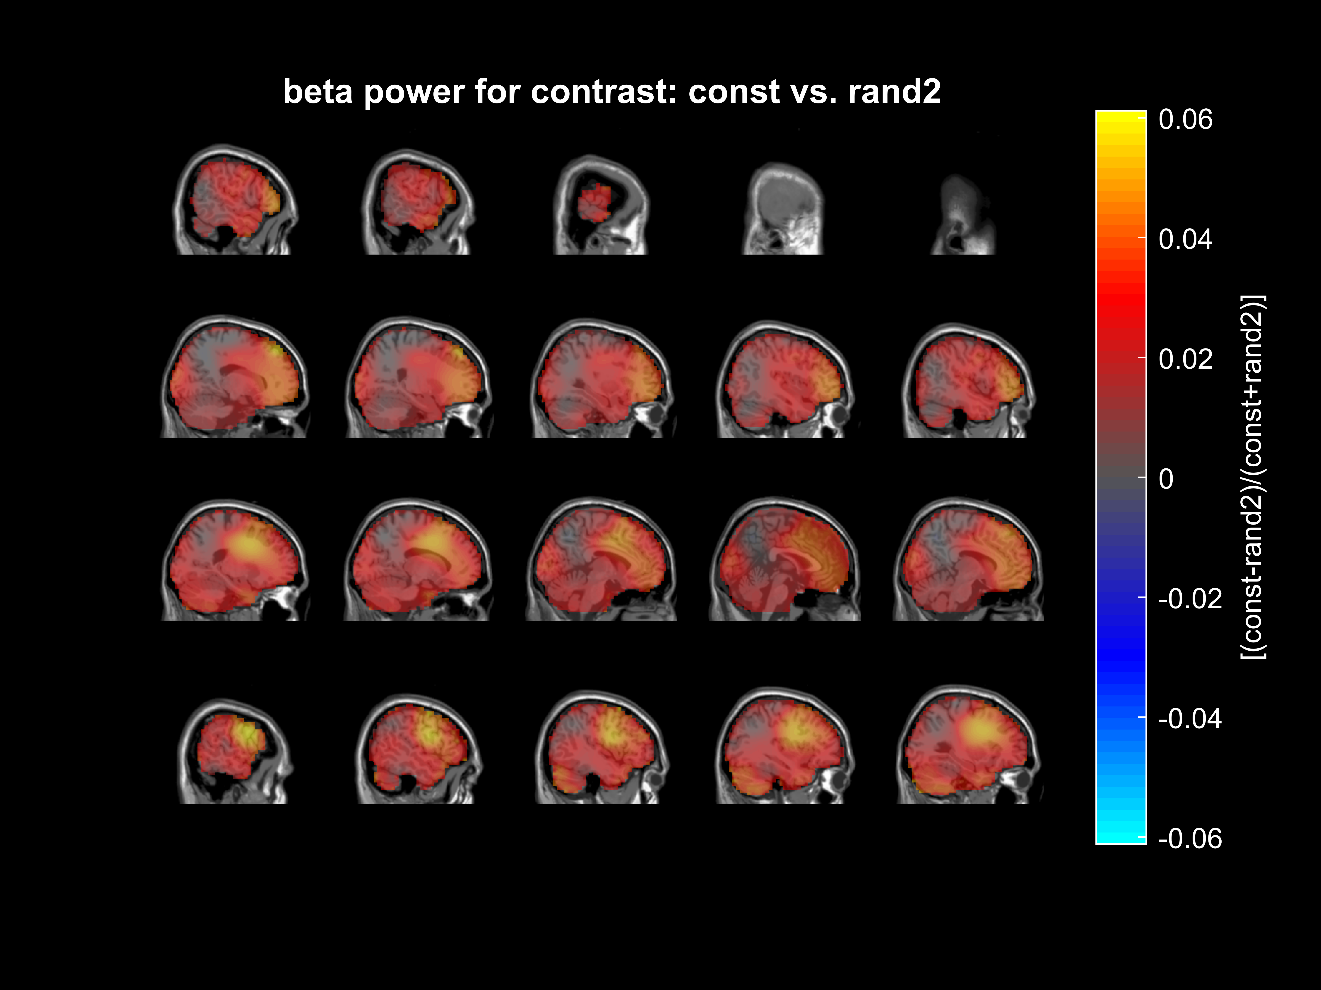
Task A: beta power
Significant time interval: 0 – 432 ms
Significant time interval: 0 – 420 ms

Slide 8
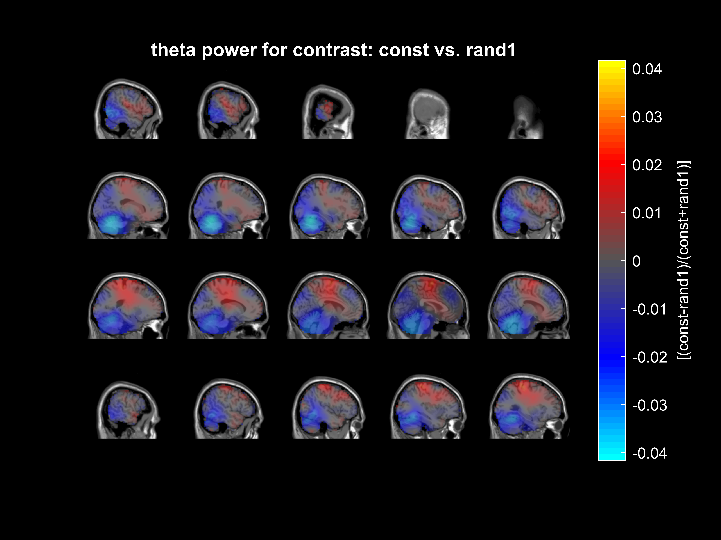

Task A: theta power
Significant time interval: 0 – 1.96 s
Significant time interval: 0.1 – 0.8 s

Slide 9
Wavelet analysis & cluster-based permutation test
Morlet wavelet: 5 cycles, length of wavelet kernel = 3 (same for all frequencies)
Frequencies: 1 to 35 Hz
Cluster based permutation test:
Monte-Carlo, 1000 iterations, alpha = 0.001, cluster alpha = 0.001
For alpha, beta and theta band
Averaged in frequency dimension, not in time dimension

Slide 10
Task A: trajectory segments
3 trajectory segments: random1, constant, random2 (each 3 seconds long)
Next slides: power calculated by wavelet analyses for each trajectory segment
+ difference between power in constant and both random trajectory segments (i.e. subtracted constant – random)

